Slide 1


SAP S/4HANA Training
MASTER DATA GOVERNANCE (SAP MDG)
Neeraj Gupta
Session 27
SAP MDG – Consolidation & Mass Processing

Slide 2
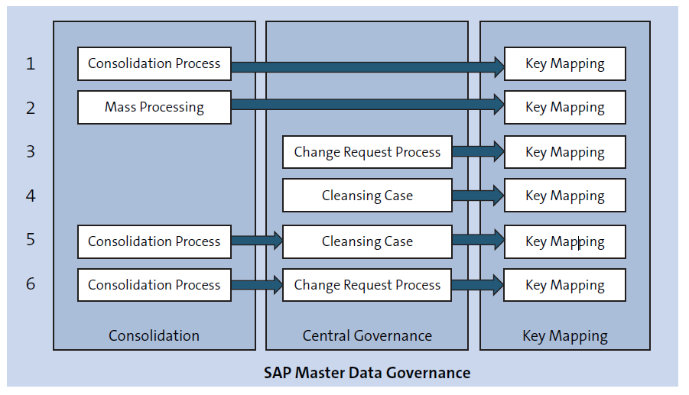
Consolidation and Central Governance Use cases
27
SAP MDG – Consolidation and Mass Processing

Slide 3
Setup steps for Consolidation and Mass Processing SFW5
27
SAP MDG – Consolidation and Mass Processing

Slide 4
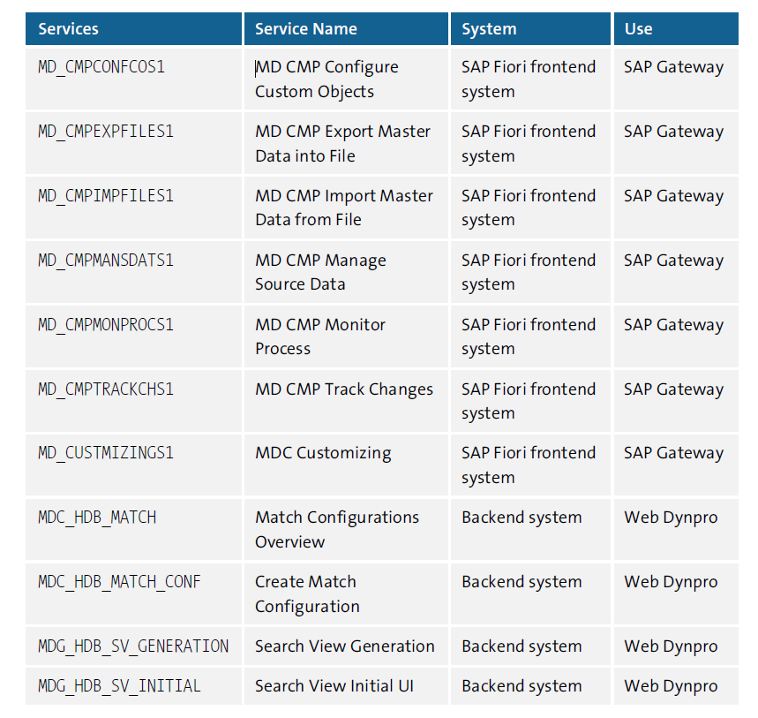
Setup steps for Consolidation and Mass Processing SICF
27
SAP MDG – Consolidation and Mass Processing

Slide 5
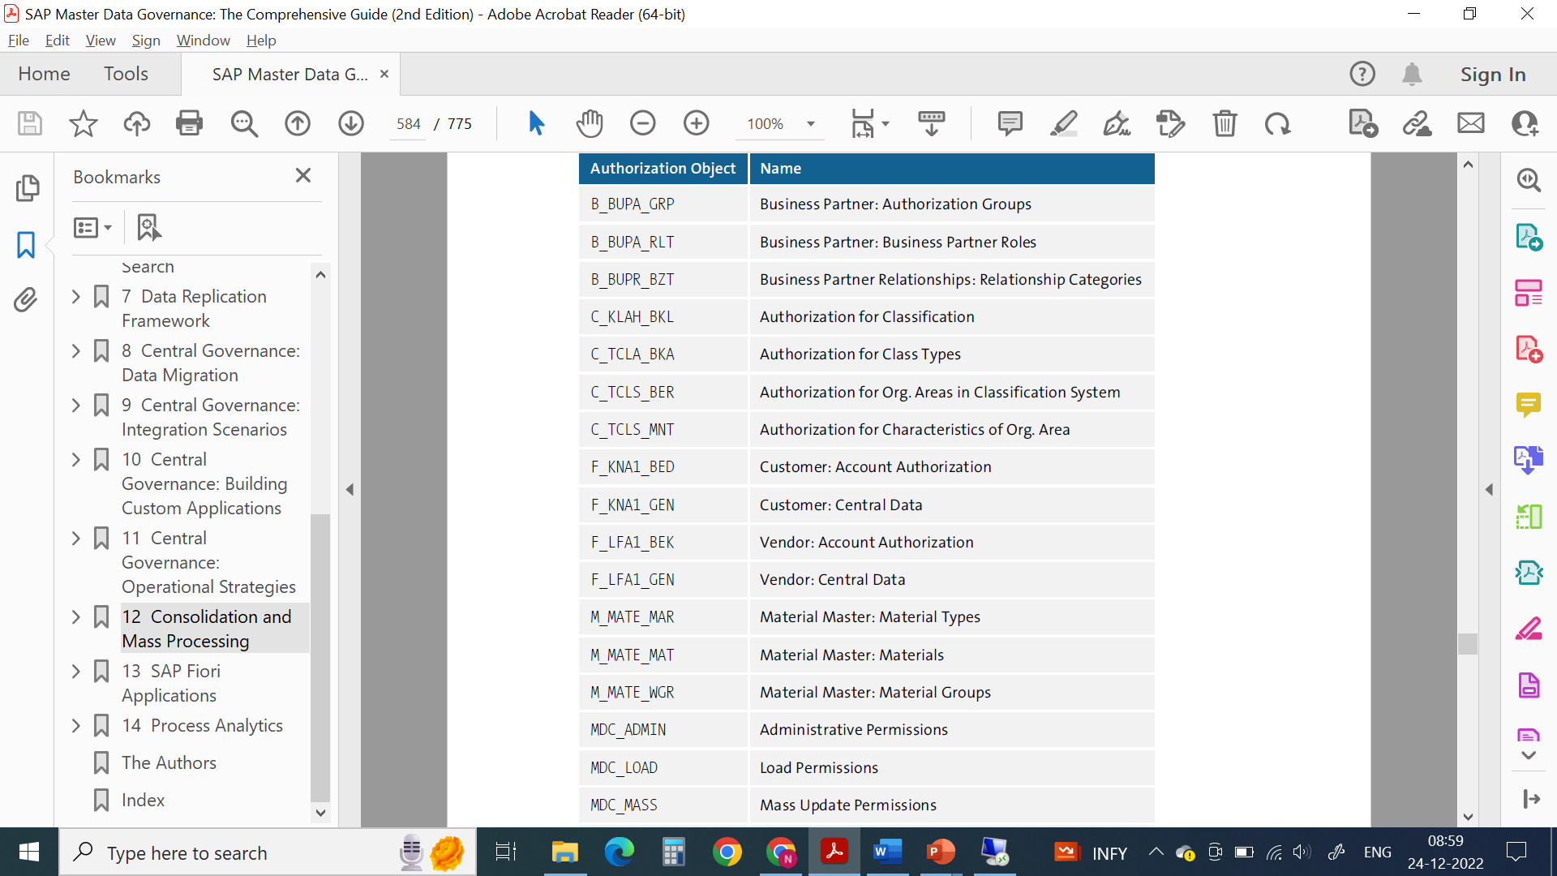
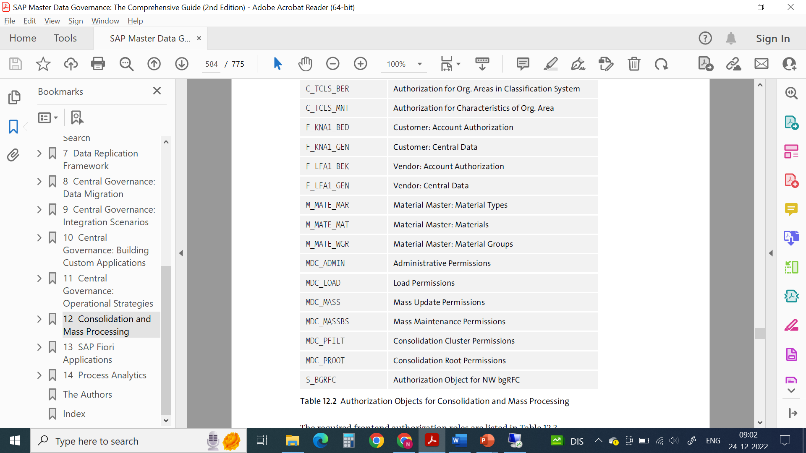
Authorization Objects
27
SAP MDG – Consolidation and Mass Processing

Slide 6
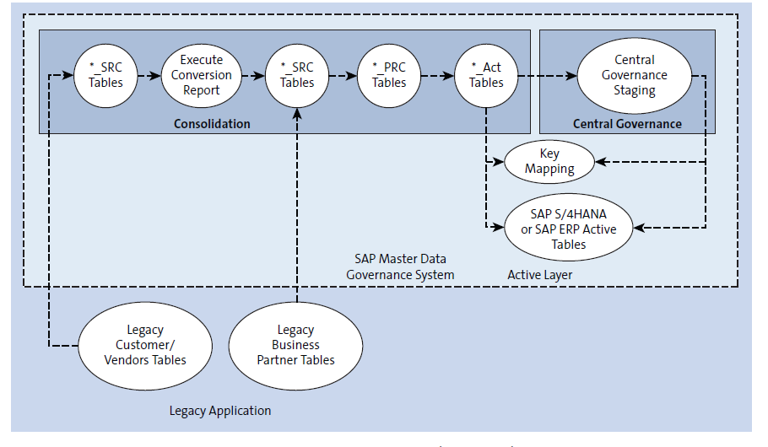
Table Types
27
SAP MDG – Consolidation and Mass Processing

Slide 7
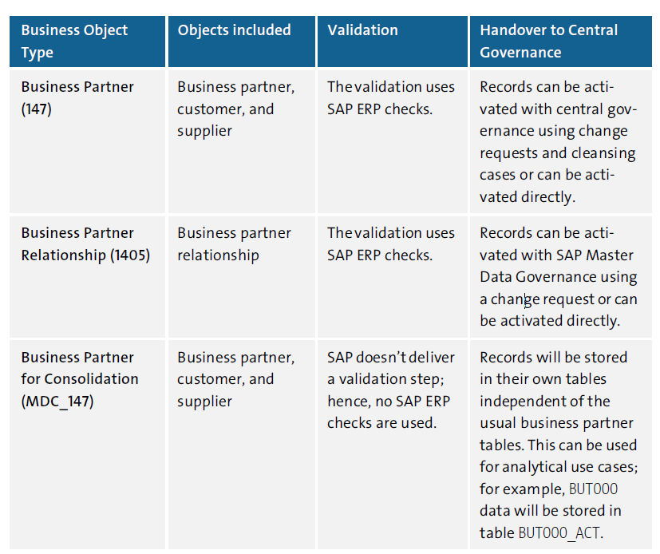
Standard BP Business Objects in MDC
27
SAP MDG – Consolidation and Mass Processing

Slide 8
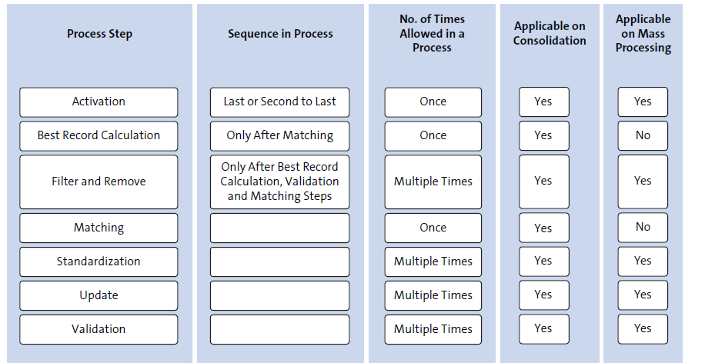
Process Template Principles
27
SAP MDG – Consolidation and Mass Processing

Slide 9

End of Session 27

Slide 10

Questions

Slide 11

Neeraj Gupta

Slide 12


We’re committed to empower you to be
Most Desirable Resource
through powerful training solutions.
We build the workforce of the future.
250+
Corporate Clients
30,000+
Learners Trained
25000+
Learners Placed
FREE WEBINARS
Sign up for free webinars with industry experts every fortnight!
Enroll Now!
Contact us today!
https://anubhavtrainings.com/

Slide 13




More from AnubhavTrainings.com

